Slide 1
Unit 1

Slide 2
Frame buffer organization and types of Frame buffers

Slide 3
What is frame buffer??
A framebuffer ( frame store) is a portion of random-access memory (RAM) containing a bitmap that drives a video display.
It is a memory buffer containing data representing all the pixels in a complete video frame.
Modern video cards contain framebuffer circuitry in their cores.
This circuitry converts an in-memory bitmap into a video signal that can be displayed on a computer monitor.

Slide 4
A frame buffer is a large, contiguous piece of computer memory.
At a minimum there is one memory bit for each pixel.
This amount of memory is called a bit plane. The picture is built up in the frame buffer one bit at a time.
A memory bit has only two states, therefore a single bit plane yields a black-and white display.
A frame buffer is a digital device and the CRT is an analog device.
Therefore, a conversion from a digital representation to an analog signal must take place when information is read from the frame buffer and displayed on the raster CRT graphics device.
For this you can use a digital to analog converter (DAC).
Each pixel in the frame buffer must be accessed and converted before it is visible on the raster CRT.

Slide 5
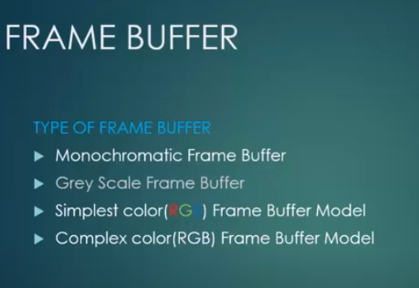

Slide 6
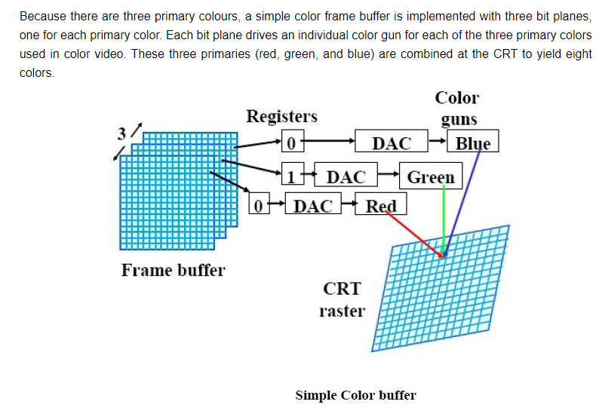
Working of frame buffer

